Slide 1
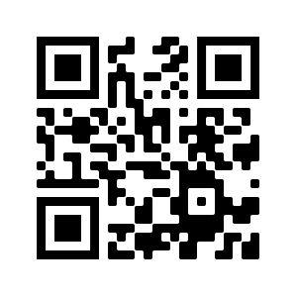
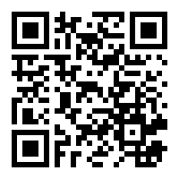
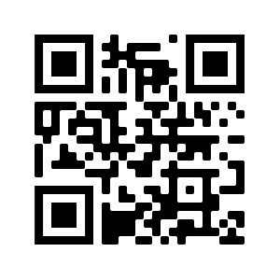
Don’t let social isolation get to you
We are here for you
Thomas Dolmark thomas.dolmark@uts.edu.au
While we are waiting for other people to join
What did you discover this week ?
in general
Join the UTS FEIT discord server
https://discord.gg/6ADjAbM
Talk to ProgSoc at UTS
https://www.facebook.com/ProgSoc/
FEIT DSA discord
https://discord.gg/jsrzt6E

Slide 2
How is everyone feeling ?
Positive notes from last week
Some of you liked not having to take public transport

Slide 3
Week 2 Summary
What did we talk about ?
What did you retain ?
What did you forget ?
I have sent a google link via email, did you get it ?
Attendance
Send me a private chat message with your student ID

Slide 4
Week 3 topics
Quiz 1 is due 5 PM this Friday
Open book, as much time as you need but only ONCE
On the ed platform
Access modifiers in C++
Exception handling
I/O with files
Stacks in C++
Cpp and header
If you still don’t have access let us know

